Slide 1
IT 206: Object-Oriented Techniques for IT Problem Solving
Strings

Slide 2
Overview of Strings
A string is a sequence of characters
You have already used string literals in previous programs
E.g. JOptionPane.showMessageDialog(null, "Print String");
Java provides a number of classes to store and process strings: String, StringBuilder, StringBuffer
In most cases, you will use the String class to create Strings unless you need to worry about program speed or concurrent usage of the program
See Java API for more details

Slide 3
The String Class Constructor
You can instantiate a String object from a string value or from an array of characters
To create a String from a string literal, use the following:
String aString = new String("This is a String");
To create a String from an array of characters, use the following:
char data[] = {'h', 'e', 'l', 'l', 'o'};
String aString = new String(data);

Slide 4
The String Class: Immutable
A String object is immutable. Once it is created, its contents cannot be changed
Because Strings are immutable and frequently used, Java has a shorthand initializer for creating a String
String course = "IT 206";

Slide 5
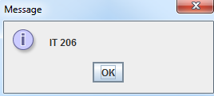

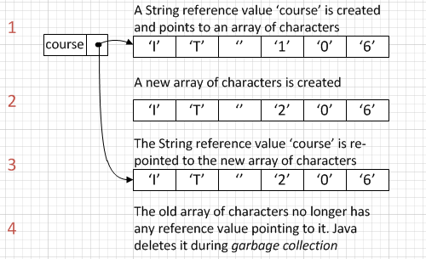
The String Class: Immutable (Cont'd)
Consider the code:
What happens?

Slide 6
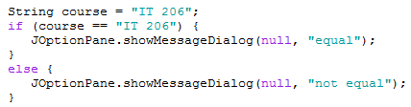
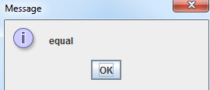
The String Class: Equality Comparisons
When programming, you may need to compare the contents of two or more Strings
Use caution when using the == comparison operator
Only does an equality check for memory location not a comparison of the contents of the Strings
One exception – When Strings are created through the same character sequence, they are interned and are chained to the same reference value
JVM does this for performance reasons

Slide 7
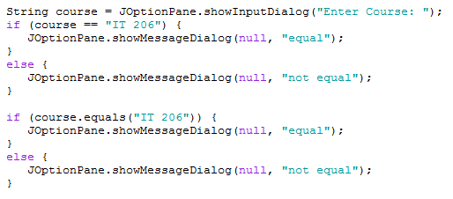
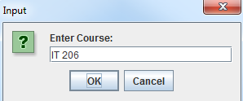
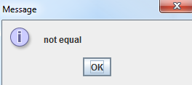
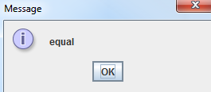
The String Class: Equality Comparisons (Cont'd)
Always use the equals() or equalsIgnoreCase() methods when comparing String contents

Slide 8
The String Class: Lexiographical Comparisons
Sometimes you need to compare two Strings to see which comes first alphabetically
In Java, it is based on the Unicode value of each character (http://unicode-table.com/en/)
0-9 comes before A-Z which comes before a-z (Remember, Java is case-sensitive!)
Use compareTo() or compareToIgnoreCase()
Methods return one of the following:
Negative Integer: The contents of the first String are lexicographically before the second String
0: The contents of the first String are lexicographically equal to the second String
Positive Integer: The contents of the first String are lexicographically after the second String

Slide 9
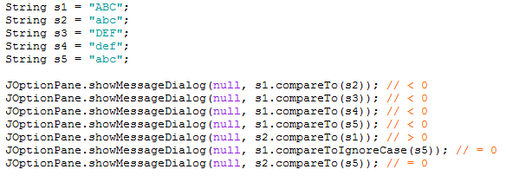
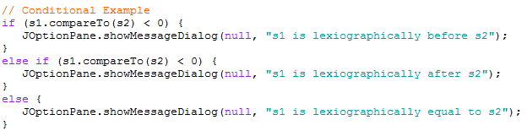
The String Class: Lexiographical Comparisons (Cont'd)
Executes!

Slide 10
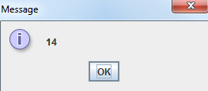
The String Class: Finding String Length
To find the length of a String, use the length() method
If you need to loop through all of the characters in the String the length() method can be used to determine the number of characters

Slide 11
The String Class: Retrieving Individual Characters
Do not refer to characters by array notation
E.g. StringName[index]
Use StringName.charAt(index)
Index values start at 0

Slide 12

The String Class: String Concatenation
When one String is concatenated to another it is logically "added" to create a new String
"IT " + "206" = "IT 206"
Because it is frequently done, Java simplifies the syntax by allowing the use of "+" to denote concatenation

Slide 13
The String Class: Extracting Substrings
Extracting a single character from a String can be done using the charAt() method
Extracting a set of characters (substring) from a String can be done using the substring() method
Two options to call the method (overloaded)
One parameter – Extract a String starting at a specific position to the end of the String
Two parameters – Extract a String starting at a specific position to another position

Slide 14
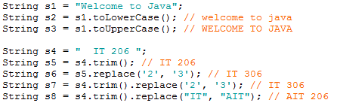
The String Class: String Conversions
The contents of a String are immutable (unchangeable) after creation, but it can be converted to a new String using a method. Some include:
toLowerCase – Convert all characters to lower case
toUpperCase – Convert all characters to upper case
trim – Remove all leading and trailing whitespace
replace(oldChar, newChar) – Replace one character with another
replace(oldString, newString) – Replace one string with another
Methods can also be chained – Executed from left to right

Slide 15

The String Class: Finding a Character or Substring within a String
Sometimes you may want to check if a String contains a character or subset of characters
Use the indexOf() method
Returns the index of the first position the character is found or -1 if not found

Slide 16
The Character Class: More Available Methods

Slide 17

String vs. Character Classes
Methods of the String class are primarily instance methods – therefore called "attached" to an object
Methods of the Character class are static therefore called "attached" to the class name

Slide 18
Questions?

Slide 19
Problem Solving with String and Character Classes

Slide 20
Extract the Area Code from a Phone Number
Assume the user has entered in their phone number in the format of: XXX-XXX-XXXX
What code can be used to extract the area code?

Slide 21
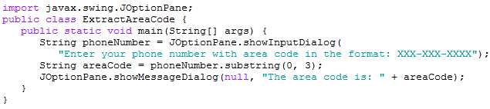
Extract the Area Code from a Phone Number (Cont'd)
Steps:
Take the first 3 characters of the string holding the full phone number
Output (or process) that substring

Slide 22
Extract the Domain Name from an Email Address
Assume the user has entered in their email address
What code can be used to extract the email domain?

Slide 23
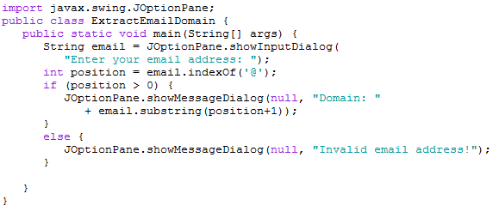
Extract the Domain Name from an Email Address (Cont'd)
Steps:
First find out if the String entered contains a @
If it does, get all of the characters after the @

Slide 24
Validate a Zip Code
A valid zip code consists of 5 or 9 digits
What code can be used to validate the zip code?

Slide 25
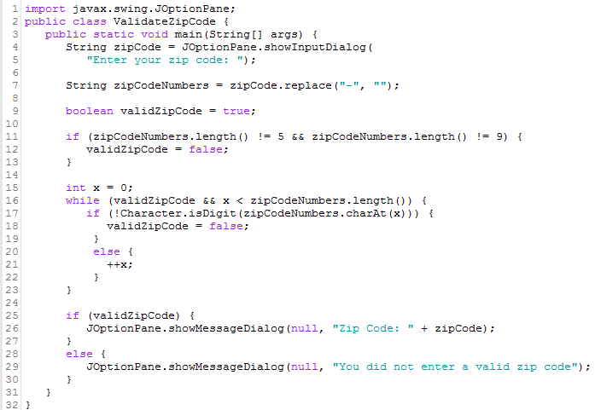
Validate a Zip Code (Cont'd)
Steps:
Remove the hyphen, if provided
Why? Handles different user entry possibilities
Check the length – 5 characters or 9 characters
If the number of characters is correct, make sure all characters are numbers

Slide 26
Summary
Using the Character and String classes, a number of extraction and data validation can occur with data
These things should typically occur in the Data Definition Class as they relate to the data itself and not the implementation of it

Slide 27
Questions?

